Slide 1

PREDICTING CUSTOMER BUYING BEHAVIOUR
1/1/2024

Slide 2
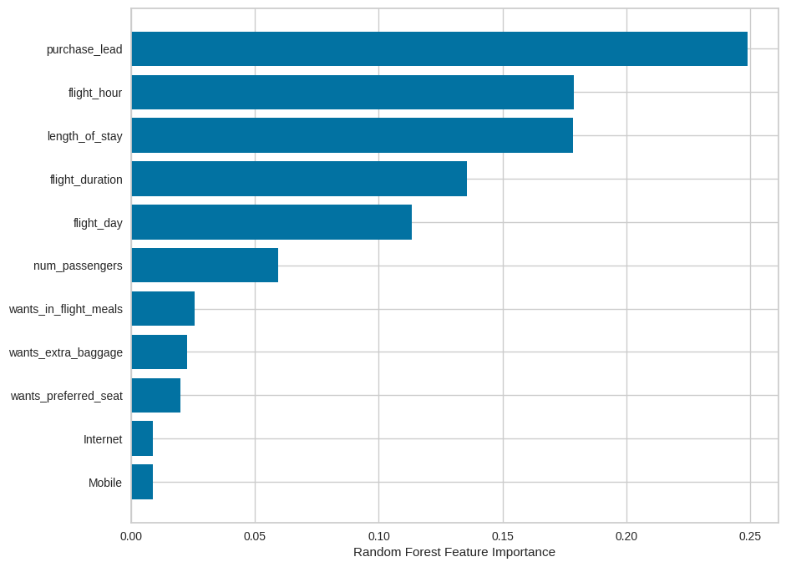
PREDICTIVE MODEL TO UNDERSTAND FACTORS THAT INFLUENCE BUYING BEHAVIOUR
We have trained the data set with Random forest classifier model and received
ACCURACY: 0.6
Precision: 0.6
Recall : 0.59
Specificity : 0.61
F-1 Score : 0.6
purchase_lead is the most important feature.
flight_ hour and length_of_stay play the vital
important features as an attribute for customer
to come and buy.
Based on customer segmentation on the same number most people come and buy tockets through internet over the phone.

Slide 3
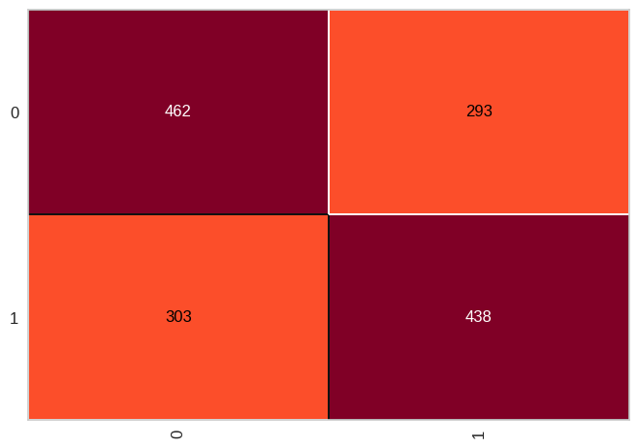
PREDICTIVE MODEL TO UNDERSTAND FACTORS THAT INFLUENCE BUYING BEHAVIOUR

